Slide 1
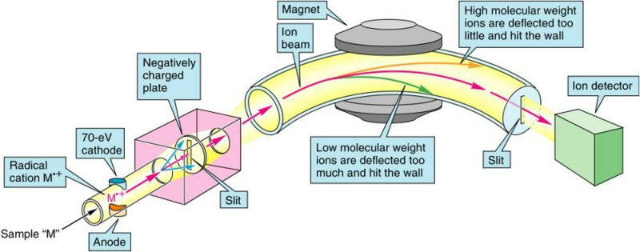
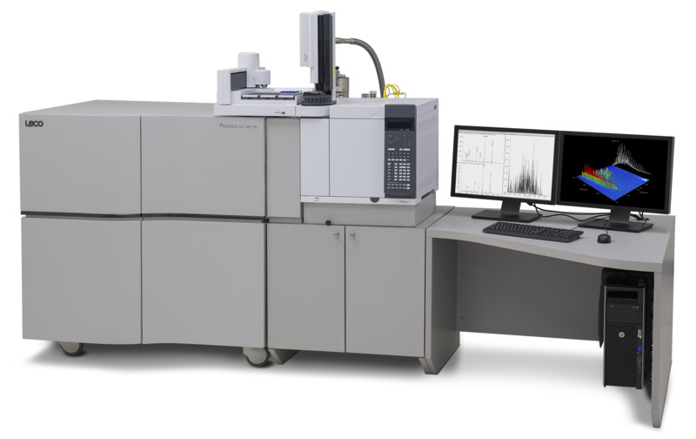
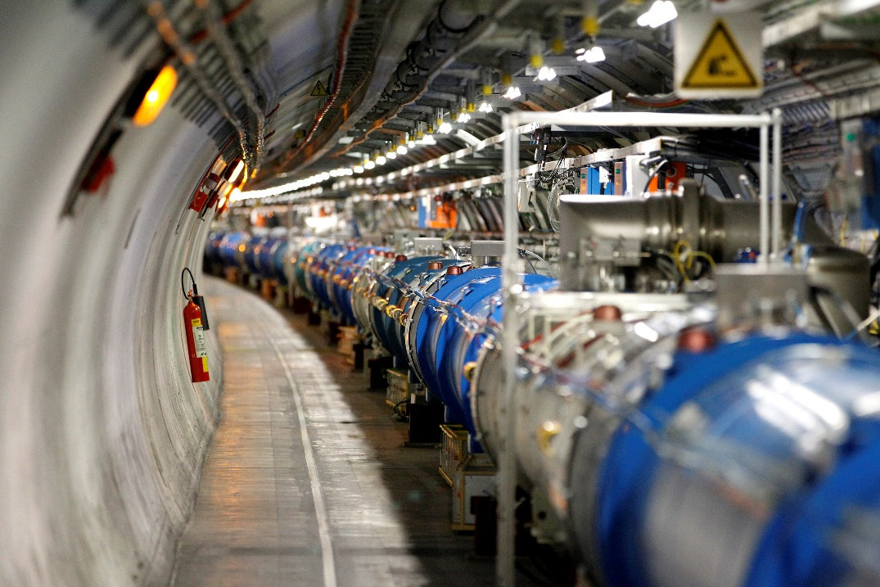
The Interaction of Magnetic Fields The Motor Effect – Part 2 (5.2)

Slide 2

Interaction between current carrying conductors and a magnetic fields.
→ The Motor Effect
More Physics Gang Signs
Motor Effect Calculations – Force and Torque

Slide 3

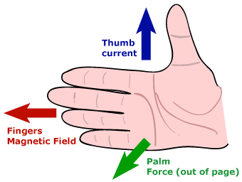
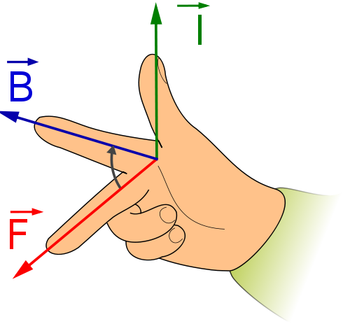
Charged Particles in Magnetic Fields
Combining Topics – Fields and Circular Motion
The Mass Spectrometer
Charged particles in the Earth’s magnetic field.

Slide 4
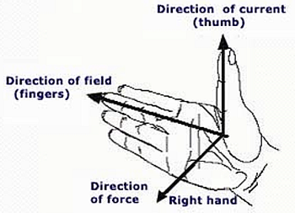
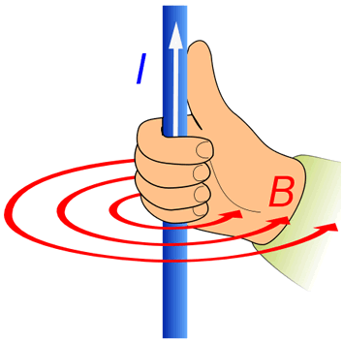
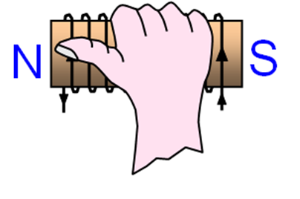
Revision- Physics “Gang Signs”
Note:
Magnetic field direction is from NORTH to SOUTH
Current direction is from POSITIVE to NEGATIVE

Slide 5
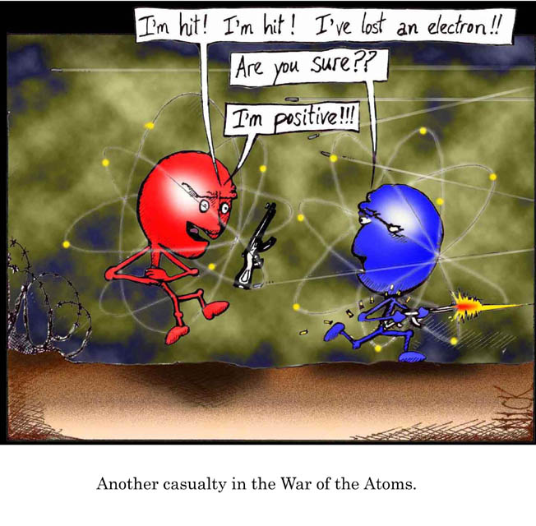
The force on a moving charge in a magnetic field
We have already learnt that a current experiences a force in a magnetic field….
but … a current is just made of moving charges…..
therefore, moving charges themselves must also experience a force in a magnetic field.
This is referred to as a Lorentz force.

Slide 6
Charge deflection by a magnetic field
Electric charges are deflected by magnetic fields provided they are not travelling parallel to the field lines.
Positive and negative charges are deflected in opposite directions.
This is equivalent to reversing the direction of the current in a conductor.
S
-
+
N
Notes:
6

Slide 7
The force on a moving charge in a magnetic field
Consider a positive charge q moving with speed v.
Magnetic field B out of the page
v
q

Slide 8


The force on a moving charge in a magnetic field
Since the particle is moving it will cover a distance in a given time dependent on its velocity. The distance travelled is equivalent to the length of the conductor in wires.
$$v=\frac{s}{t}$$
v
q
$$v=\frac{L}{t}$$

Slide 9

The force on a moving charge in a magnetic field
$$L=vt$$
In time Δt the charge will have moved a distance
v
q

Slide 10

The force on a moving charge in a magnetic field
From year 11 Physics we know that current is given by
$$I=\frac{q}{t}$$
v
q

Slide 11
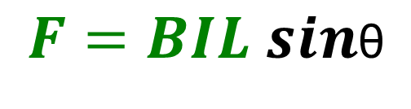




The force on a moving charge in a magnetic field
In Conductors force was given by
$$F=BIL sin\text{θ}$$
$$F=B\frac{q}{t}vt sin\text{θ}$$
$$I=\frac{q}{t}$$
v
q
$$F=Bqv sin\text{θ}$$
$$L=vt$$
Where θ is the angle
between the magnetic field
and direction of current.

Slide 12
The force on a moving charge in a magnetic field
How does the direction of the force on the charged particle compare to its direction of motion?
v
It is always perpendicular to motion.
q
F

Slide 13
The force on a moving charge in a magnetic field
Will the direction of the force change with time? Why or why not?
YES – because the direction of motion changes, the direction of the force will also continually change so that it is always perpendicular to motion
v
q
F

Slide 14
The force on a moving charge in a magnetic field
The fact that this force is always at right angles to the velocity means that the charge will move in a circle (if the speed is constant).
The force is therefore a Centripetal Force!
q
v
F

Slide 15
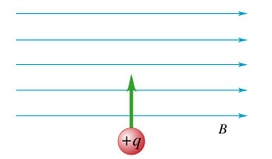
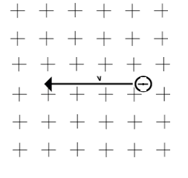
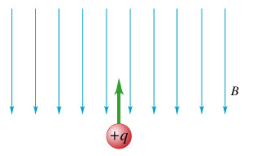
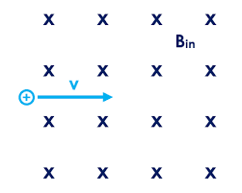
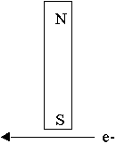
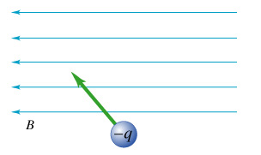
Force on a Charged Particle in a Magnetic Field
Which way will the particles be deflected in each situation below?

Slide 16
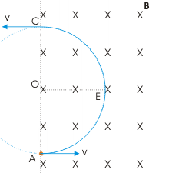
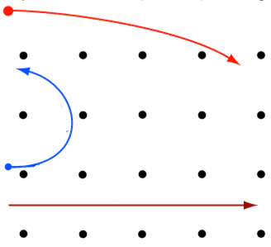
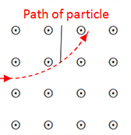
Force on a Charged Particle in a Magnetic Field
The three main types of nuclear radiation are emitted into a magnetic field. Label each path with the type of radiation it shows.
What type of charge does the particles above have?

Slide 17

Worked Example 1
In a particle accelerator, electrons are accelerated to 7.44 × 10⁴ m s⁻¹ North and then enter an upwards magnetic field of intensity 1.50 T.
Calculate the average magnetic force on each electron.
F = qvB
F = (1.60 × 10⁻¹⁹)(7.44 × 10⁴)(1.50)
F = 1.79 × 10⁻¹⁴ N
WEST

Slide 18
Worked Example 2
An electron moving with speed v = 2.00 x 10⁶ ms⁻¹ enters a uniform magnetic field of strength B=4.50T at an angle of θ = 40⁰ to the field, as shown in the diagram. Find:
The magnitude of the force on the electron
The direction of the force on the electron
What would be the force on an electron moving left to right in this field?
What would be the force on an electron moving down the page as it enters this field?
θ=40⁰

Slide 19
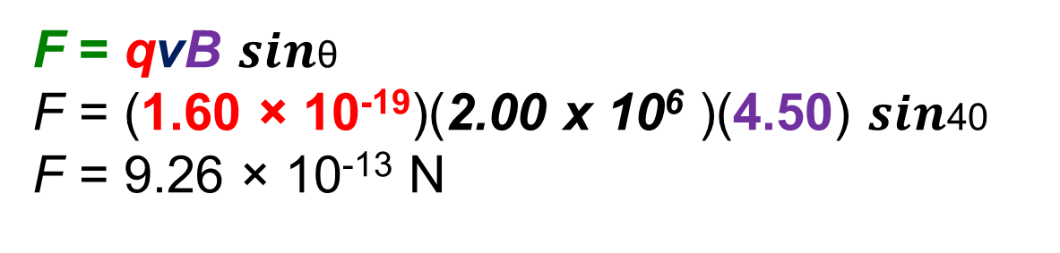
Worked Example 2
v = 2.00 x 10⁶ ms⁻¹
The magnitude of the force on the electron
The direction of the force on the electron
θ=40⁰
F = qvB $sin\text{θ}$
F = (1.60 × 10⁻¹⁹)(2.00 x 10⁶ )(4.50) $sin\text{40}$
F = 9.26 × 10⁻¹³ N
B=4.50T
The force is directed out of the page → right hand rule.

Slide 20

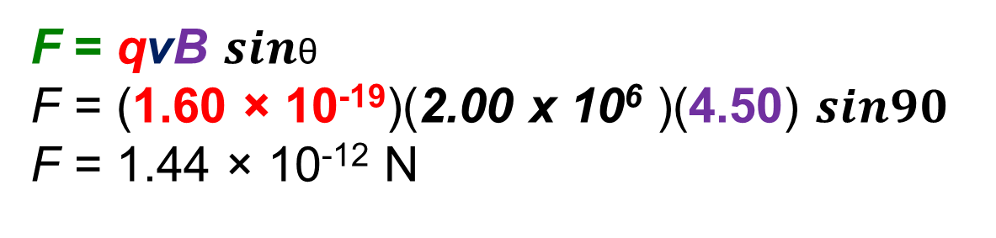
Worked Example 2
v = 2.00 x 10⁶ ms⁻¹
What would be the force on an electron moving left to right in this field?
What would be the force on an electron moving down the page as it enters this field?
θ=40⁰
The force is ZERO as electron is moving parallel to magnetic field. $\text{θ}$= 0 and Sin 0 = 0
B=4.50T
F = qvB $sin\text{θ}$
F = (1.60 × 10⁻¹⁹)(2.00 x 10⁶ )(4.50) $sin90$
F = 1.44 × 10⁻¹² N

Slide 21
Circular Motion in a Magnetic Field
Since the Force is always at right angles to the direction of motion, it results in circular motion.
As such, we can combine our knowledge of circular motion with our new understanding of the forces on charged particles as below.
F _{(centripetal)} = F _{(magnetic)}
mv² = qvB
r
Using this relationship we can predict the path of various charged particles, given their mass, velocity, charge and the strength of the magnetic field through which they move.

Slide 22
Circular Motion in a Magnetic Field
The relationship can then be simplified as follows.
F _{(centripetal)} = F _{(magnetic)}
mv² = qvB
r
mv = qB
r
mv = r
qB
Using this relationship, what does increasing each of the following do to the radius of the path followed?
m ? B? q? v?

Slide 23

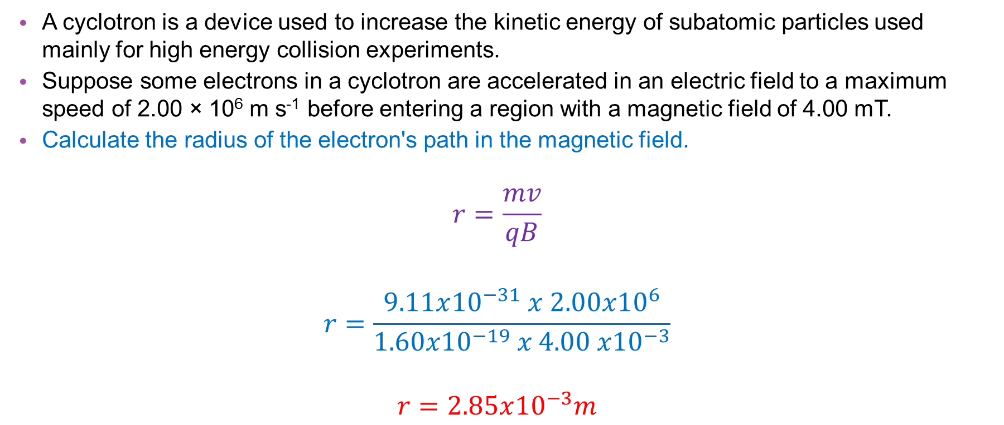
Worked Example 3
A cyclotron is a device used to increase the kinetic energy of subatomic particles used mainly for high energy collision experiments.
Suppose some electrons in a cyclotron are accelerated in an electric field to a maximum speed of 2.00 × 10⁶ m s⁻¹ before entering a region with a magnetic field of 4.00 mT.
Calculate the radius of the electron's path in the magnetic field.
$$r=\frac{mv}{qB}$$
$$r=\frac{9.11x{10}^{−31} x 2.00x{10}^{6}}{1.60x{10}^{−19} x 4.00 x{10}^{−3}}$$
$$r=2.85x{10}^{−3}m$$

Slide 24
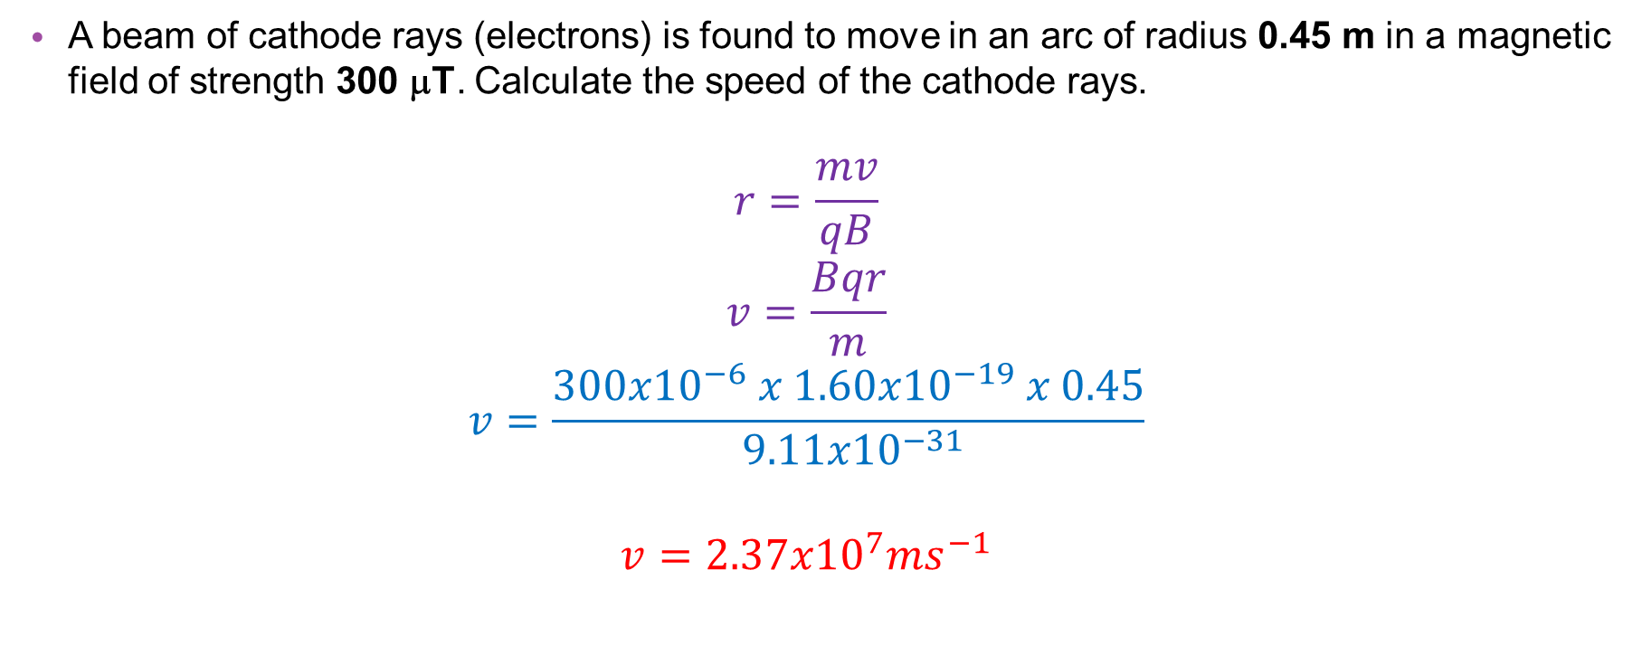
Worked Example 4
A beam of cathode rays (electrons) is found to move in an arc of radius 0.45 m in a magnetic field of strength 300 μT. Calculate the speed of the cathode rays.
$$r=\frac{mv}{qB}$$
$$v=\frac{Bqr}{m}$$
$$v=\frac{300x{10}^{−6} x 1.60x{10}^{−19} x 0.45}{ 9.11x{10}^{−31}}$$
$$v=2.37x{10}^{7}ms^{−1}$$
r = 0.45 m
B = 300 μT = 300 x 10⁻⁶ T
q = 1.6 x 10⁻¹⁹ C

Slide 25









Period of Circular Motion
Just like planets in orbit around a star, we can also find the period of orbit / revolution (or frequency) of a charged particle undergoing circular motion in a magnetic field. To do so we by using the relationship between F_{C} and F_{B}
$$\frac{2πr}{T}=\frac{Bqr}{m}$$
$$r=\frac{mv}{qB}$$
$$f=\frac{1}{T}$$
$$\frac{2π}{T}=\frac{Bq}{m}$$
$$v=\frac{Bqr}{m}$$
$$f=\frac{Bq}{2πm}$$
$2πm=$ $BqT$
$$v=\frac{2πr}{T}$$
$$T=\frac{2πm}{Bq}$$

Slide 26
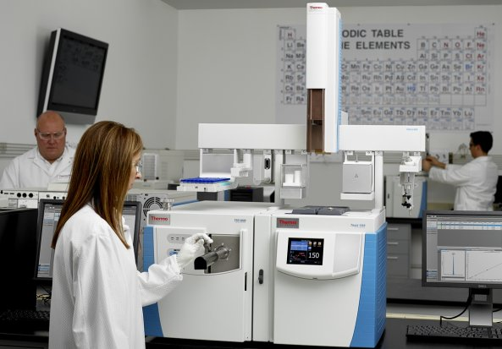
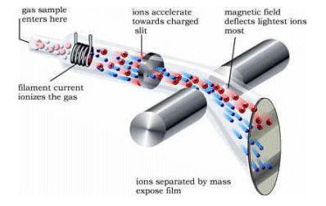
Application: Mass Spectrometers
The mass spectrometer is an instrument which can measure the masses and relative concentrations of atoms and molecules. It makes use of the basic magnetic force on a moving charged particle.
Although there are a variety of mass spectrometers, each type includes at least four basic processes:
ionisation (from an ion source)
velocity selection
deflection (due to a mass analyser)
detection.

Slide 27
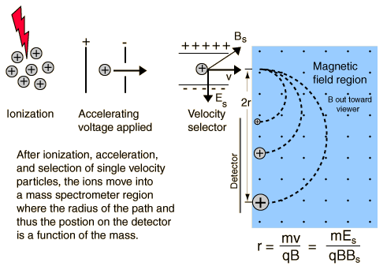
Application: Mass Spectrometers
ionisation (from an ion source)
velocity selection
deflection (due to a mass analyser)
detection.

Slide 28
Application: Mass Spectrometers
For a sample to be analysed by the mass spectrometer it needs to be ionised.
For gas or vapour samples, ionisation is often achieved by using an electron gun which directs fast moving electrons in a vacuum at the molecules or atoms of the sample.
These atoms lose one electron and become positive ions. (Thus they have a known charge.)
The positive ions are accelerated by a strong electric field which does work on the ions so that almost all have the same velocity.

Slide 29
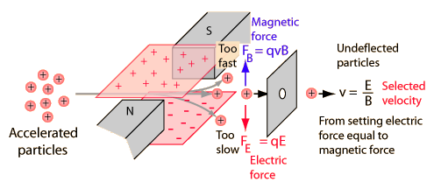
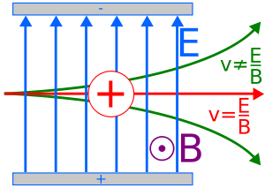
Application: Mass Spectrometers
Velocity Selector
A velocity selector is used with mass spectrometers to select only charged particles with a specific velocity for analysis.
It makes use of geometry where opposing electric and magnetic forces match for a specific particle speed.
It therefore lets through un-deflected only those particles with the selected velocity.

Slide 30



Application: Mass Spectrometers
Velocity Selector
In the first diagram the downward force is only dependent on the charge of the particle and the size of the electric field.
The upward force is determined by velocity, charge and magnetic field.
$$E=\frac{F}{q}$$
$$Fe=qE$$
$$FB=qvB$$

Slide 31
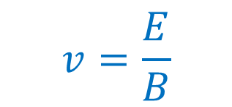





Application: Mass Spectrometers
Velocity Selector
For any two specific magnetic and electric field, there is only one velocity where the two forces will be balanced.
$$Fe=qE$$
$$FB=qvB$$
$$Fe=FB$$
$$qE=qvB$$
$$E=vB$$
$$v=\frac{E}{B}$$

Slide 32
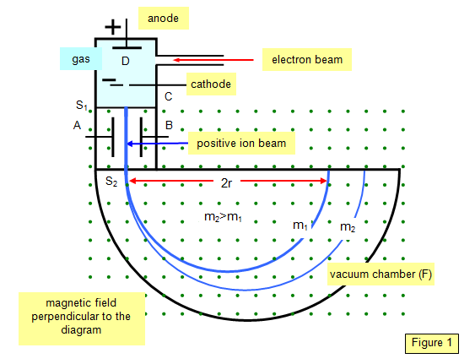
Application: Mass Spectrometers
Deflection
The charged ion with set velocity enters the deflection chamber and experiences a force due to a magnetic field alone.
This causes deflection of its path into a circular path. Ions with large masses are deflected along larger radii.
Why?

Slide 33
Application: Mass Spectrometers
Detection
The charged ion impacts a detection plate which detects the change in electrical potential due to the charge impacts.
The most simple form would have particles move through a half circle as shown.
The diameter of the circle gives radius, which will then determine the mass of the ion.

Slide 34
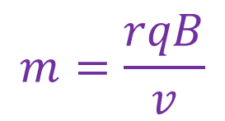
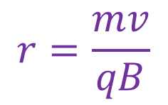
Application: Mass Spectrometers
Mass
Use the equations on your constant sheet to construct a formula that gives mass of the ion.
$$r=\frac{mv}{qB}$$
$$m=\frac{rqB}{v}$$

Slide 35
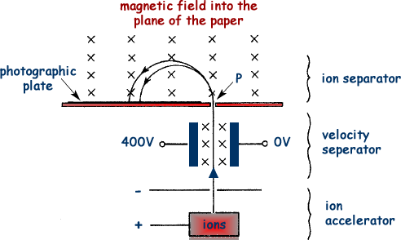







Worked Example 5 Mass Spectrometer
The magnetic field strength in the velocity selector of the mass spectrometer shown is 0.14T and the two charged plates have a separation of 2.00 cm. Calculate the velocity of particles that pass directly through the selector
$$E=\frac{V}{d}$$
$$v=\frac{E}{B}$$
$$vB=\frac{V}{d}$$
$$E=vB$$
$$v 0.14=20 000$$
$$v 0.14=\frac{400}{0.02}$$
$$v =1.43x{10}^{5}ms^{−1}$$

Slide 36
Application: Mass Spectrometers
Mass spectrometers are used to:
monitor atmospheric pollutants.
forensic analysis in crimes
detect and identify anabolic steroids in athletes
detect dioxins in contaminated fish
determine the country of origin of diamonds and wines
detect isotopes and elements present in the early solar system

Slide 37


Mass Spectrometer

Slide 38


Cathode Ray Tubes – Older Style TV’s

Slide 39


Cathode Ray Tubes – Older Style TV’s

Slide 40



Cathode Ray Tubes – Older Style TV’s

Slide 41


Slide 42


Slide 43


